Slide 1
Hotel Reservation DB Implementation
Team 5: Yoanna Spasova, Borano Llana, Eleonora Yordanova, Bulat Germanov, Yana Veitsman

Slide 2
Agenda
Choosing DBMS
Challenges
Query optimization
Sample queries

Slide 3
Choosing DBMS

Slide 4

Why MySQL?
Open source
All in one place
Intuitive interface

Slide 5
ER Modeling Challenges

Slide 6
Tables
Reservation
Room
We did our best to keep Reservation table as our main table upon which we would execute different queries. The only other table with multiple foreign keys is Room, which we connected to Rates and Hotel.

Slide 7
Solving Problems regarding the ER Modeling
(Changes from the first ER Diagram draft:)
Changed some relationships that would not work based on true life experience.
Example: one guest ID could make more than 1 reservation. Hence, we swapped from a 1 to 1 relationship to a 1 to many optional relationship.)
We decided to connect the Guest Type to the Reservation Table rather than the Guest Table. - This would later bring ease of Database Implementation.

Slide 8
Implementation Challenges

Slide 9
Implementation Challenges I - Availability
Challenge:
Need to find a way to clearly understand if a room is available
Ideas of implementation:
Varchar - “Yes” or “No”
Char - “Y” or “N”
Boolean
Boolean implementation in MySQL

Slide 10
Implementation Challenges II - Parking Dates
Challenge:
A guest should be able to book a parking space outside of the reservation dates
Solution:
Reservation table holds a parking ID as a foreign key, and the dates are separated => guest can book parking without booking a room

Slide 11
Implementation Challenges III - Time Formats
Challenge:
Choose the most suitable format for payment timestamps and dates for rooms’ reservations and parking
Solution:
Payment timestamps - DATETIME - 8 bytes
Dates for parking - DATETIME - 8 bytes
Dates for room - DATE - 3 bytes

Slide 12
Optimization of queries

Slide 13
Comments on Optimizing Queries
1. Inner Joins vs. Subqueries
2. Avoid using NOT
3. Convert data types only when truly necessary
4. Replace HAVING with WHERE
5. Unions vs. Subqueries

Slide 14
Sample queries

Slide 15
Query I: Average Rates by Guest Type
Goal:
Calculate the average rates for each guest type and order by the average rate amount from the biggest to the lowest

Slide 16
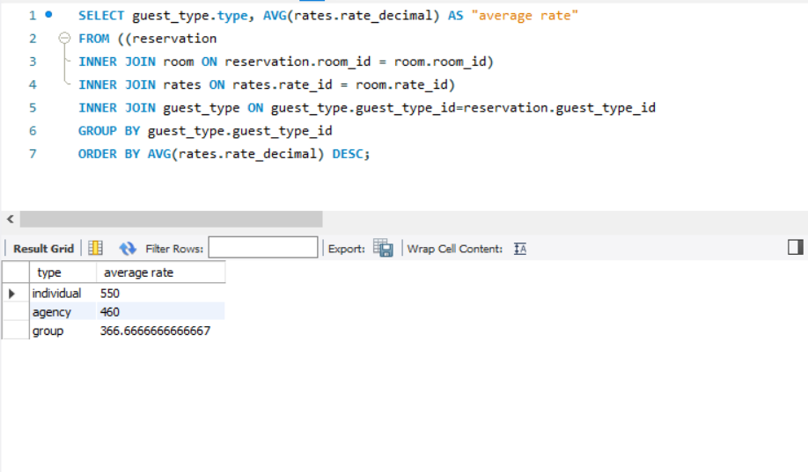
Using JOINs to collect data from rooms and rates tables
Grouping by guest_type
Calculating average via AVG

Slide 17
Query II:
Goal:
Select the id, hotel branch and location of the hotels which do not have rooms available

Slide 18
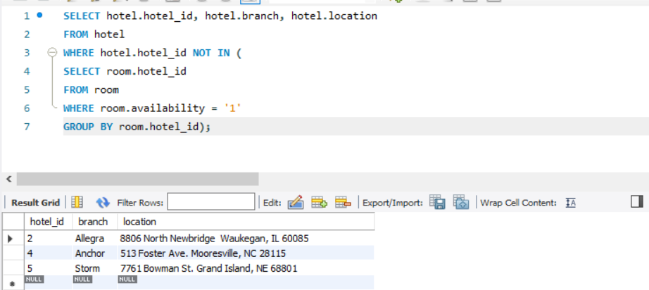
Using subqueries to select hotels with booked rooms
Get additional information for each hotel from the hotel tale

Slide 19
Query III:
Goal:
Select the meal plan descriptions of all guests and sort by guest_id

Slide 20
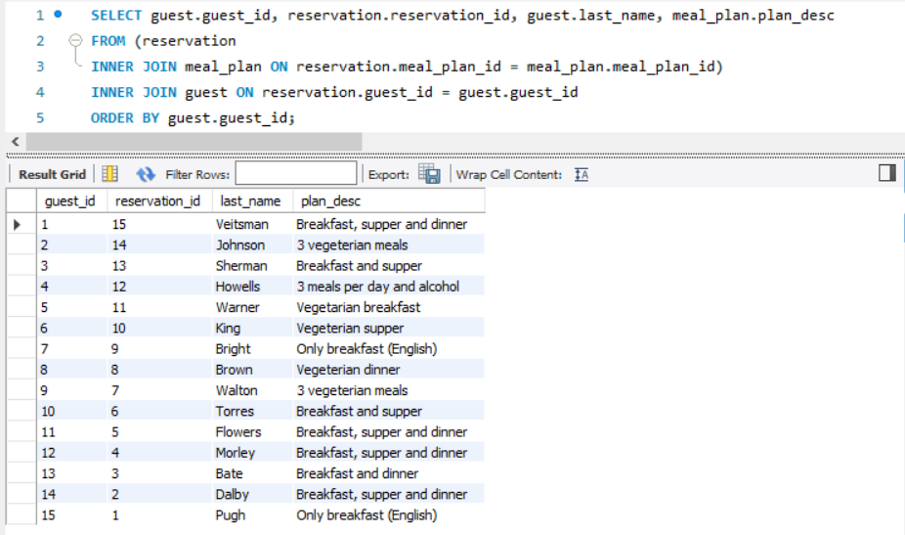
Using 2 INNER JOINs to get the data about meal plans for each reservation and guest
Order by guest_id

Slide 21
Query IV:
Goal:
Get the ids, names and phone numbers of all the guests who booked rooms for November 5th, 2020

Slide 22
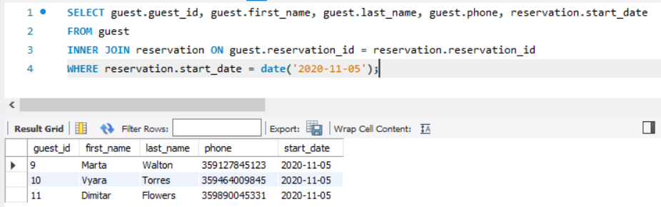
Using an INNER JOIN to connect the reservation with the guest
Specify the date with WHERE condition

Slide 23
Query V:
Goal:
Select the employees' names, ids, and how many customers they served from 4th to 6th (inclusively) of November 2020; order by the employees' ids

Slide 24
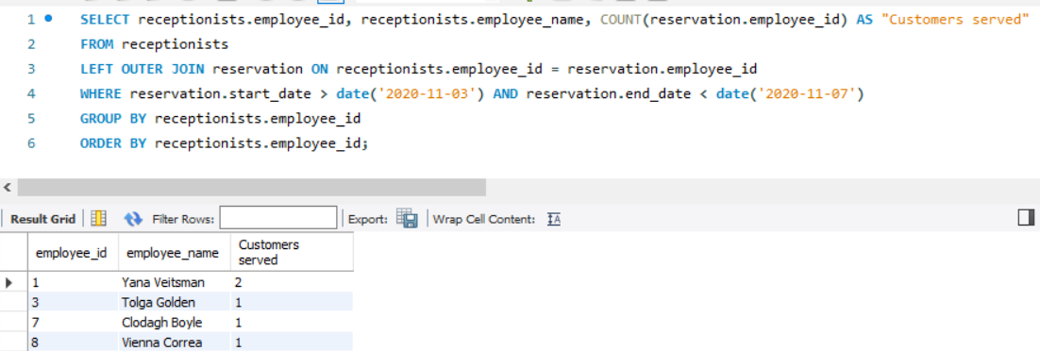
Use LEFT OUTER JOIN to get all the workers’ ids
Use COUNT to count customers served
Specify the dates in the WHERE condition
GROUP and ORDER BY employee_id

Slide 25
That’s it!
We are ready to deploy ;)

